Slide 1
REVIEW SPRINT E

Slide 2
Content
Promised requirements
Demo
Reflection on system architecture

Slide 3
Promised requirements
Editing interests (3)
UI work (8)
Creating stories (8)
Newsfeed with friends' stories (13)
Settings page with a delete account (5)
Finishing (4)
Logout button (2)
Translating (10)
Proper private account handling (1)
Total points 54
Done
Not done

Slide 4
DEMO

Slide 5
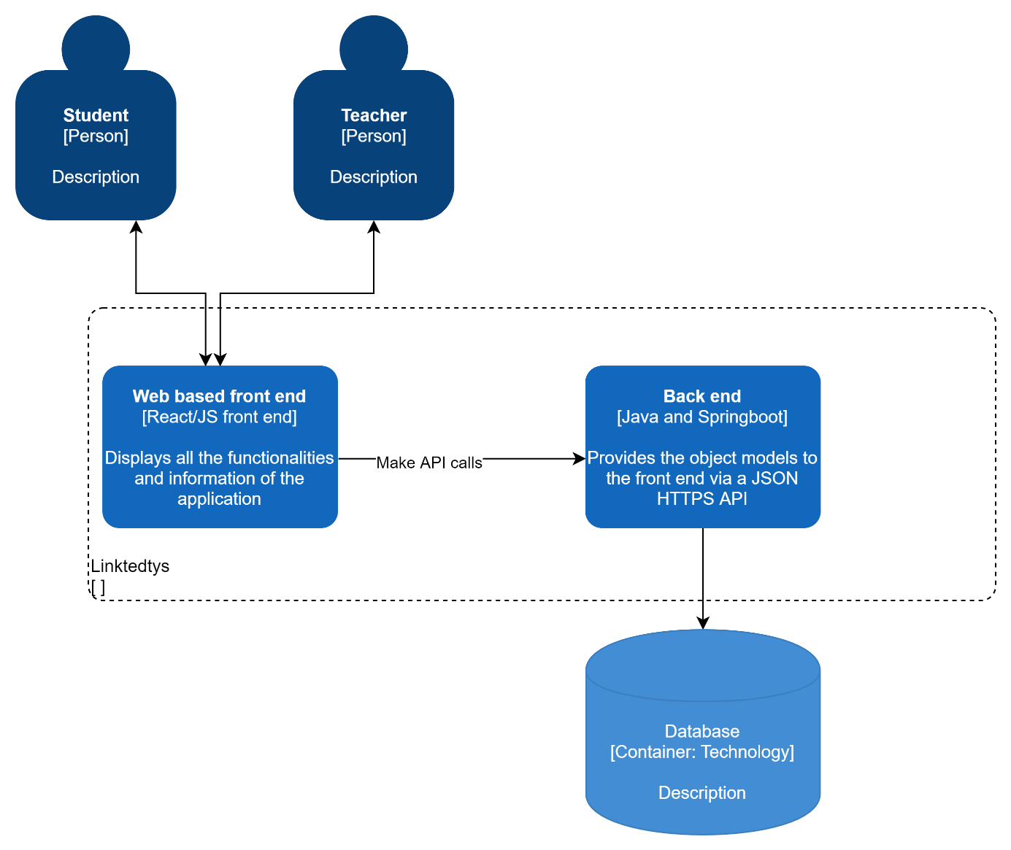
Reflection on system architecture
Easier to collaborate
Very flexible
Way of deployment is adequate
No continuous deployment

Slide 6
Individual Reflection
1. Tim
2. Guido
3. Angel
4. Arend
5. Joan

Slide 7
END

